Slide 1

Case Study
1 Aug 10 – 20 Sep 10

Slide 2
Study Conditions
Only traffic from English speaking countries
No adult, gambling, firearms, sensitive, or banned domains by upstream provider.
Domain must have available referrers
Selection of domains for study must be representative of domains parked in aggregator without selective bias
Outlier domains with > 100 impressions per day and < 1 impression during the study were excluded from results
Domains must previously had been tested substantially across a wide variety of other domain parking providers and alternative solutions
Revenue comparisons were made for two different time periods. Historic data on domain revenue for the previous six weeks was compared against the following six weeks provided by Domain Advertising. Although this time skew can be a major factor in short low volume tests – the magnitude of difference between providers cannot be contributed to this discrepancy.

Slide 3
System Eligibility
Density algorithm technology must pre-optimize domain phrases in advance of traffic being sent
Domains had to be capable of categorization (auto or human)
Category must be enabled on Domain Advertising design system
Domains for study had preliminary human optimization applied

Slide 4
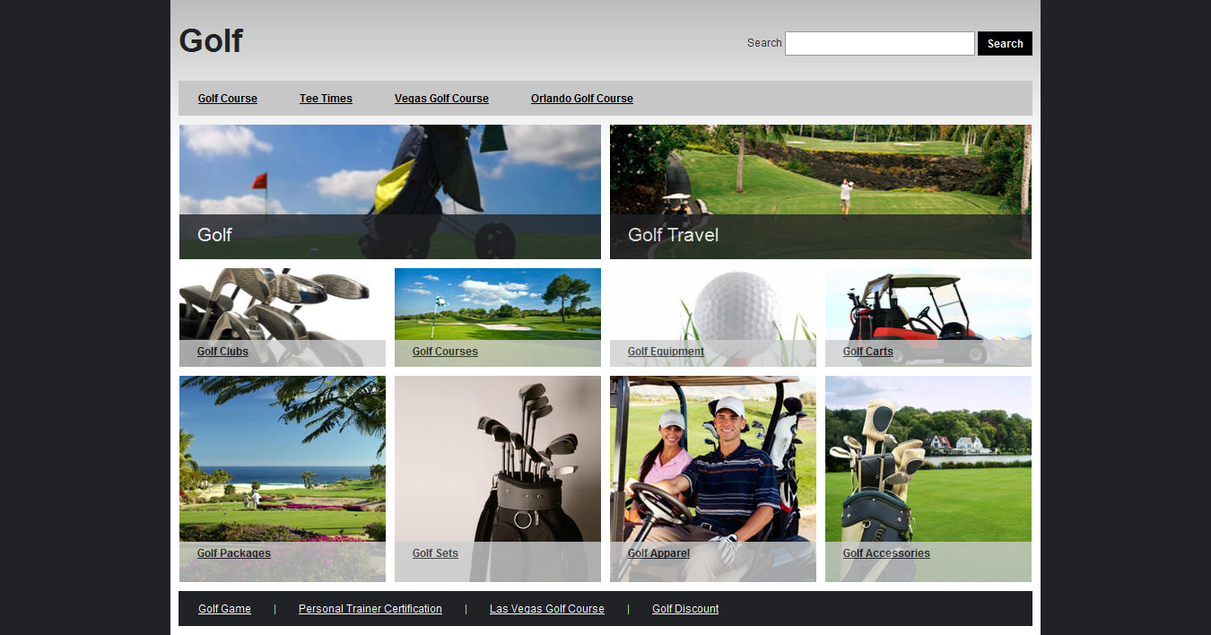
Typical Implementations

Slide 5
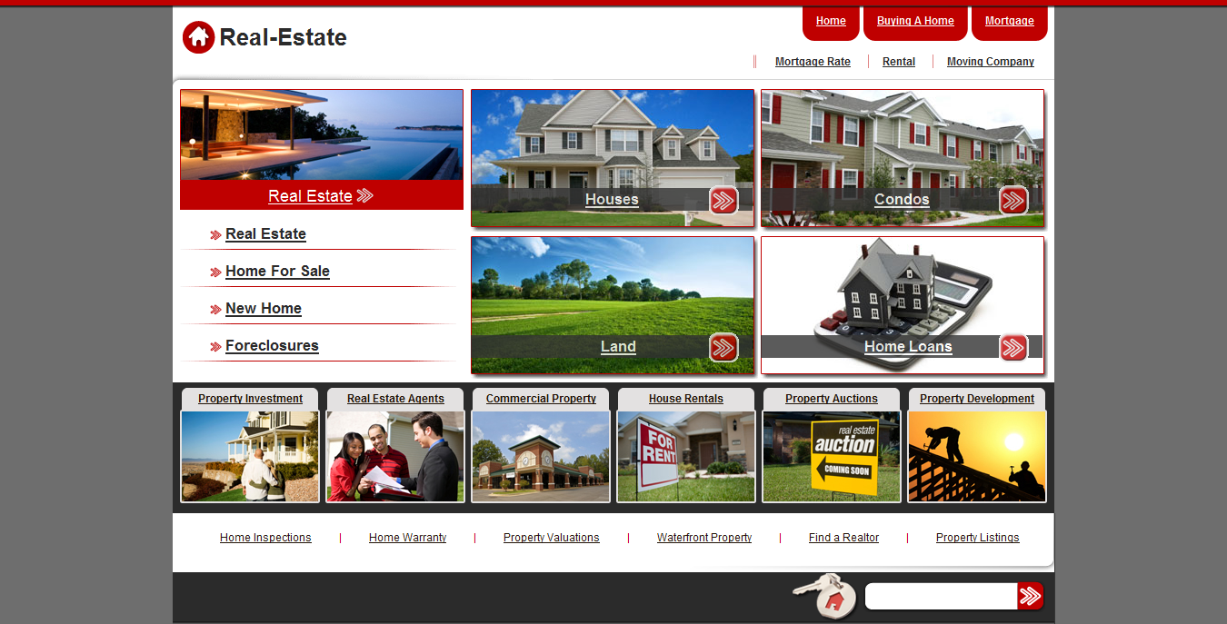
Typical Implementations

Slide 6

Typical Implementations

Slide 7
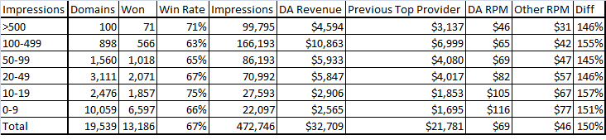
Gross Results
67% of domains performed better on the Domain Advertising system under test conditions.
On aggregate there was a 50% increase in revenue for the domains tested
A very consistent result was achieved across all volume ranges

Slide 8
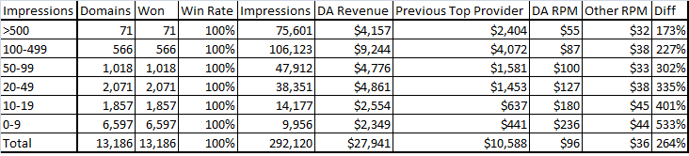
Optimized Results
There was a 164% increase in revenue for the 67% of domains which were “won” by the Domain Advertising provider
Almost a $100 RPM aggregate revenue was achieved on those winning domains

Slide 9
Further Examination
Park Logic had to create special control systems to optimize traffic for this study. To replicate the test similar systems would need to be created by other providers to verify results.
Domain Advertising performed better in 67% of the domain cases which left 33% of domains which were sub-optimal in this study. Further optimization or improvements are required.
Foreign traffic is volatile and can skew results dramatically between domains. For this reason non English speaking traffic was not included in this study. Another study needs to be performed to analyse the efficacy of the Domain Advertising technology in non-English speaking markets. Domain Advertising publishes pages in 32 different languages.

Slide 10
Conclusion
Domain Advertising has proven that in English speaking markets and non-specialist domains that it produces dramatic revenue improvements.
Park Logic has proven that traffic segmentation and analysis to optimize performance has strong benefits for the domain owner to maximize profitability. Even when a single provider has outstanding results they cannot be the best solution for every domain or user segment.
Every domain needs to be examined and utilized on a case by case basis. If you would like to try and replicate these results for yourself, you can do so now with existing technology.
Website Contacts:
  DomainAdvertising.com
  ParkLogic.com

