Slide 1
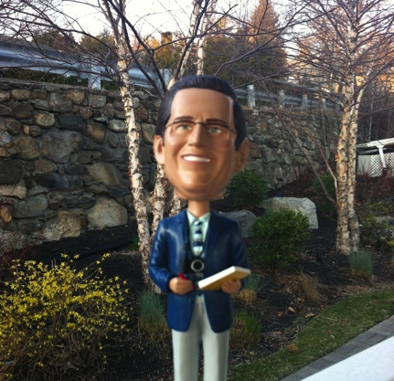
Night out with Ron Jackson
Starring: Ron Jackson of DN Journal
Co-Starring: Gregg McNair, Jeff Gabriel, Tessa Holcomb,
Amanda Waltz and Gina Aubrey of DomainAdvisors

Slide 2
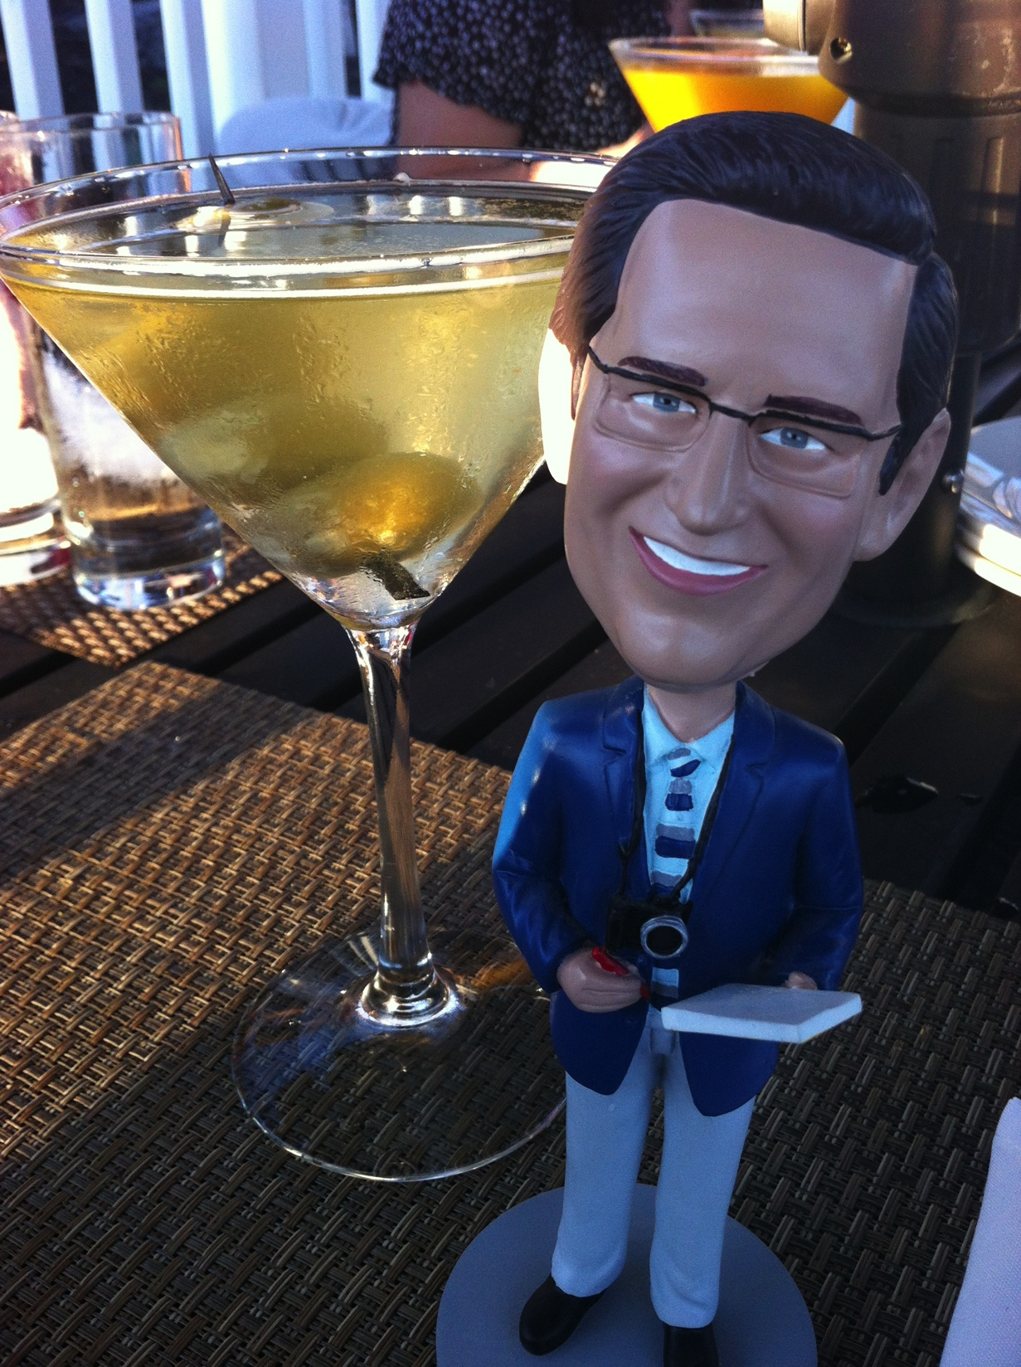
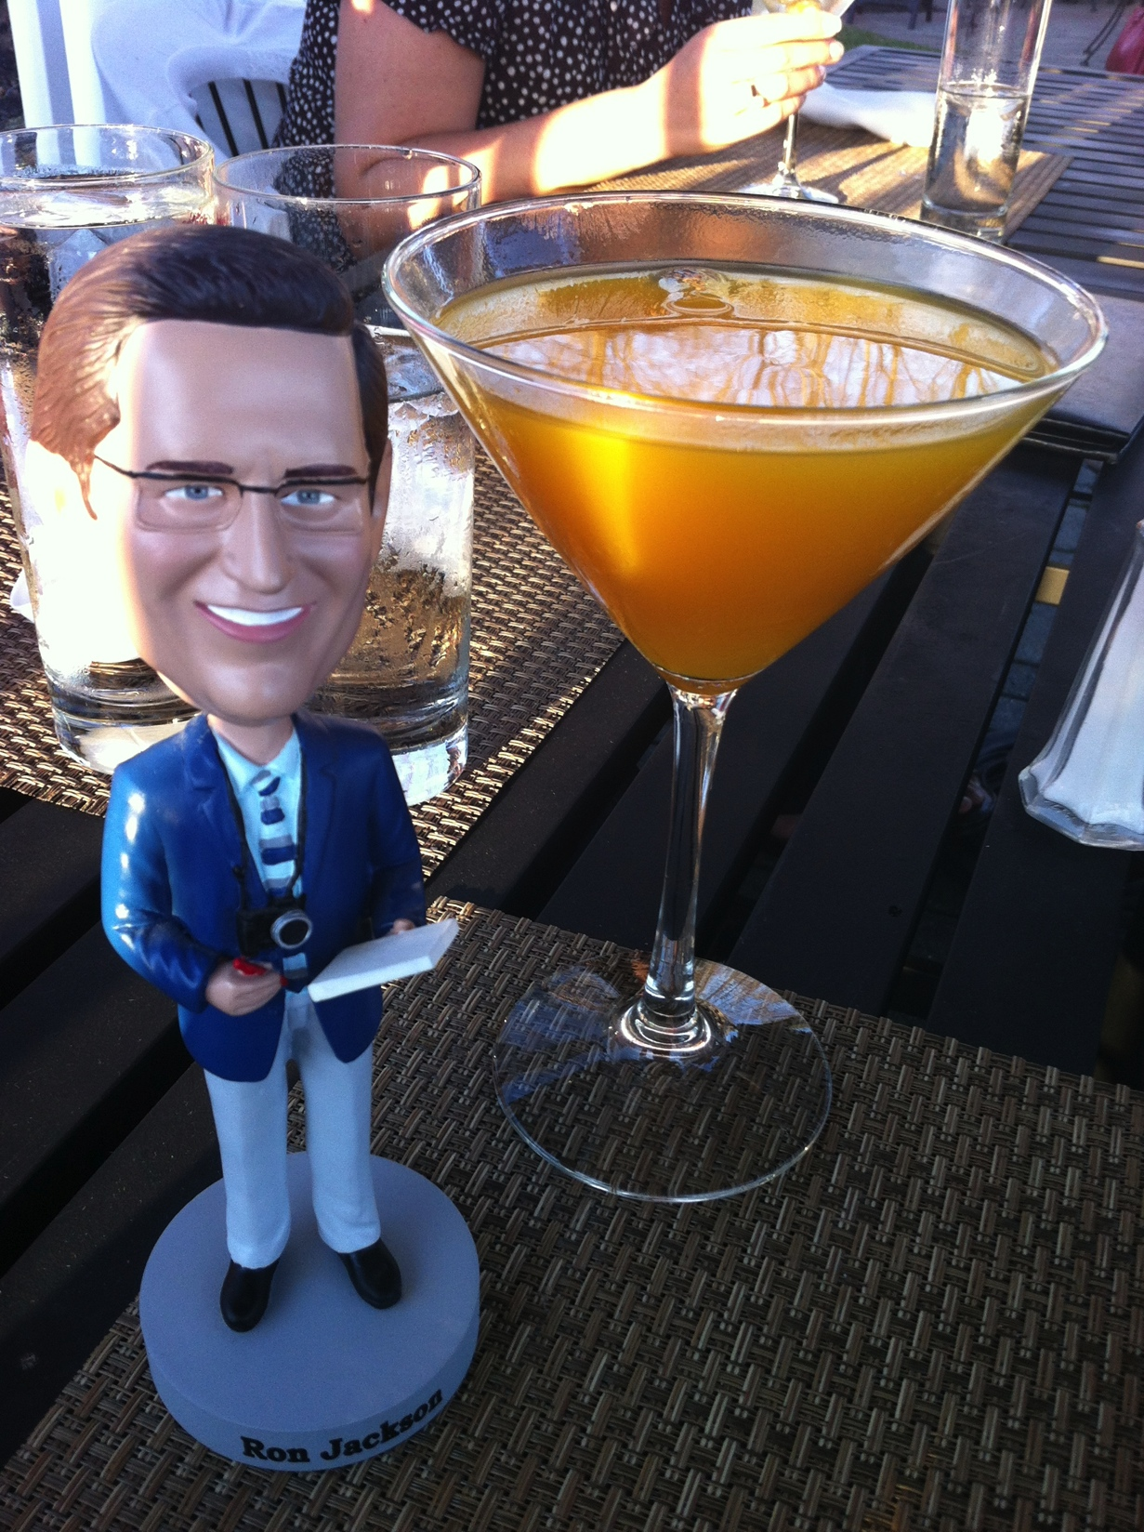
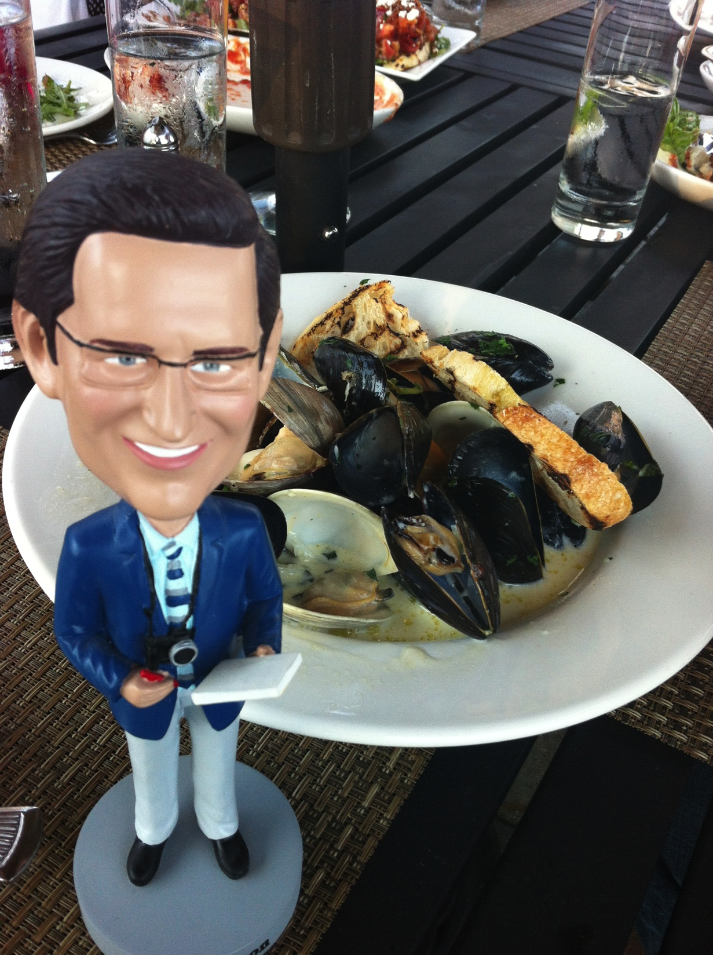
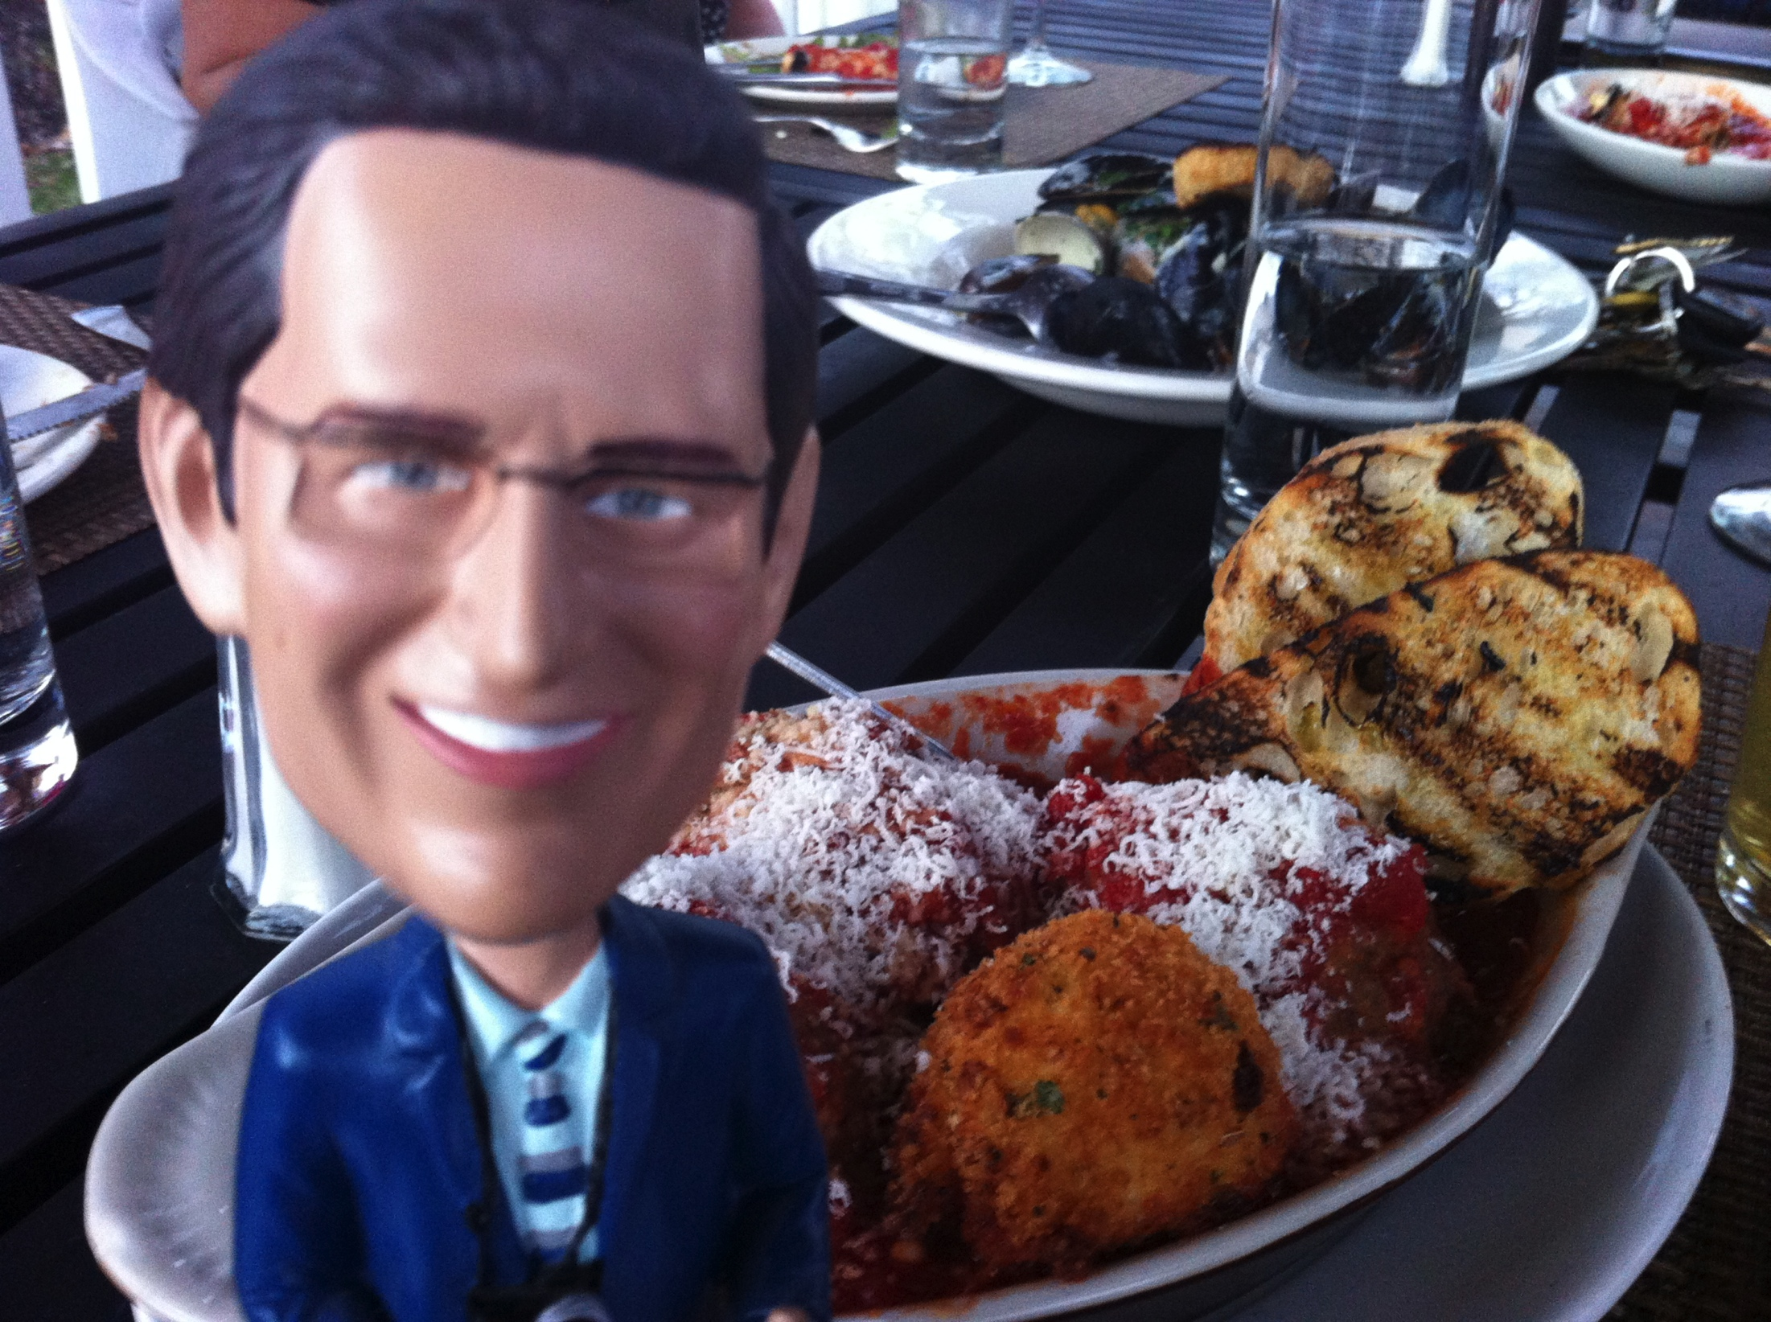
Drinks & Apps
We weren’t really sure what you’d like so we got you a bit of everything!

Slide 3
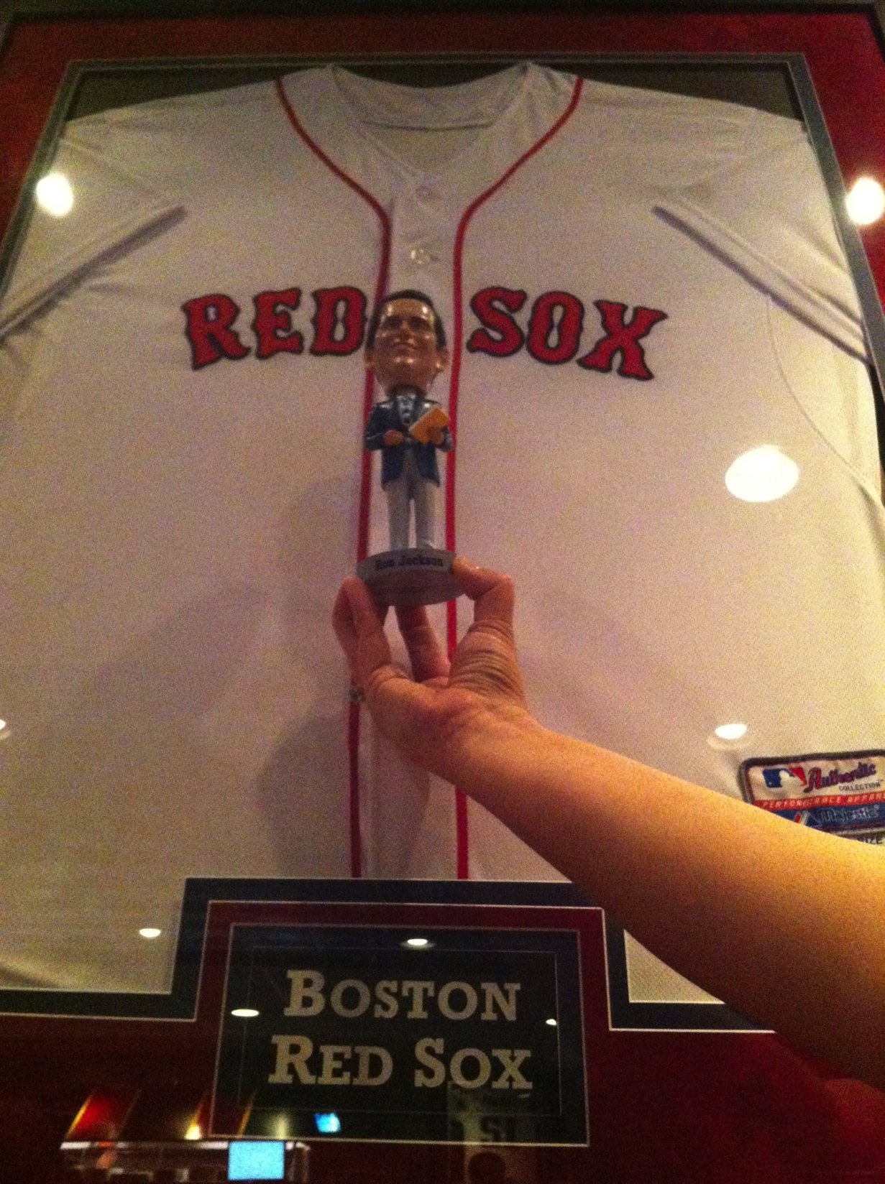
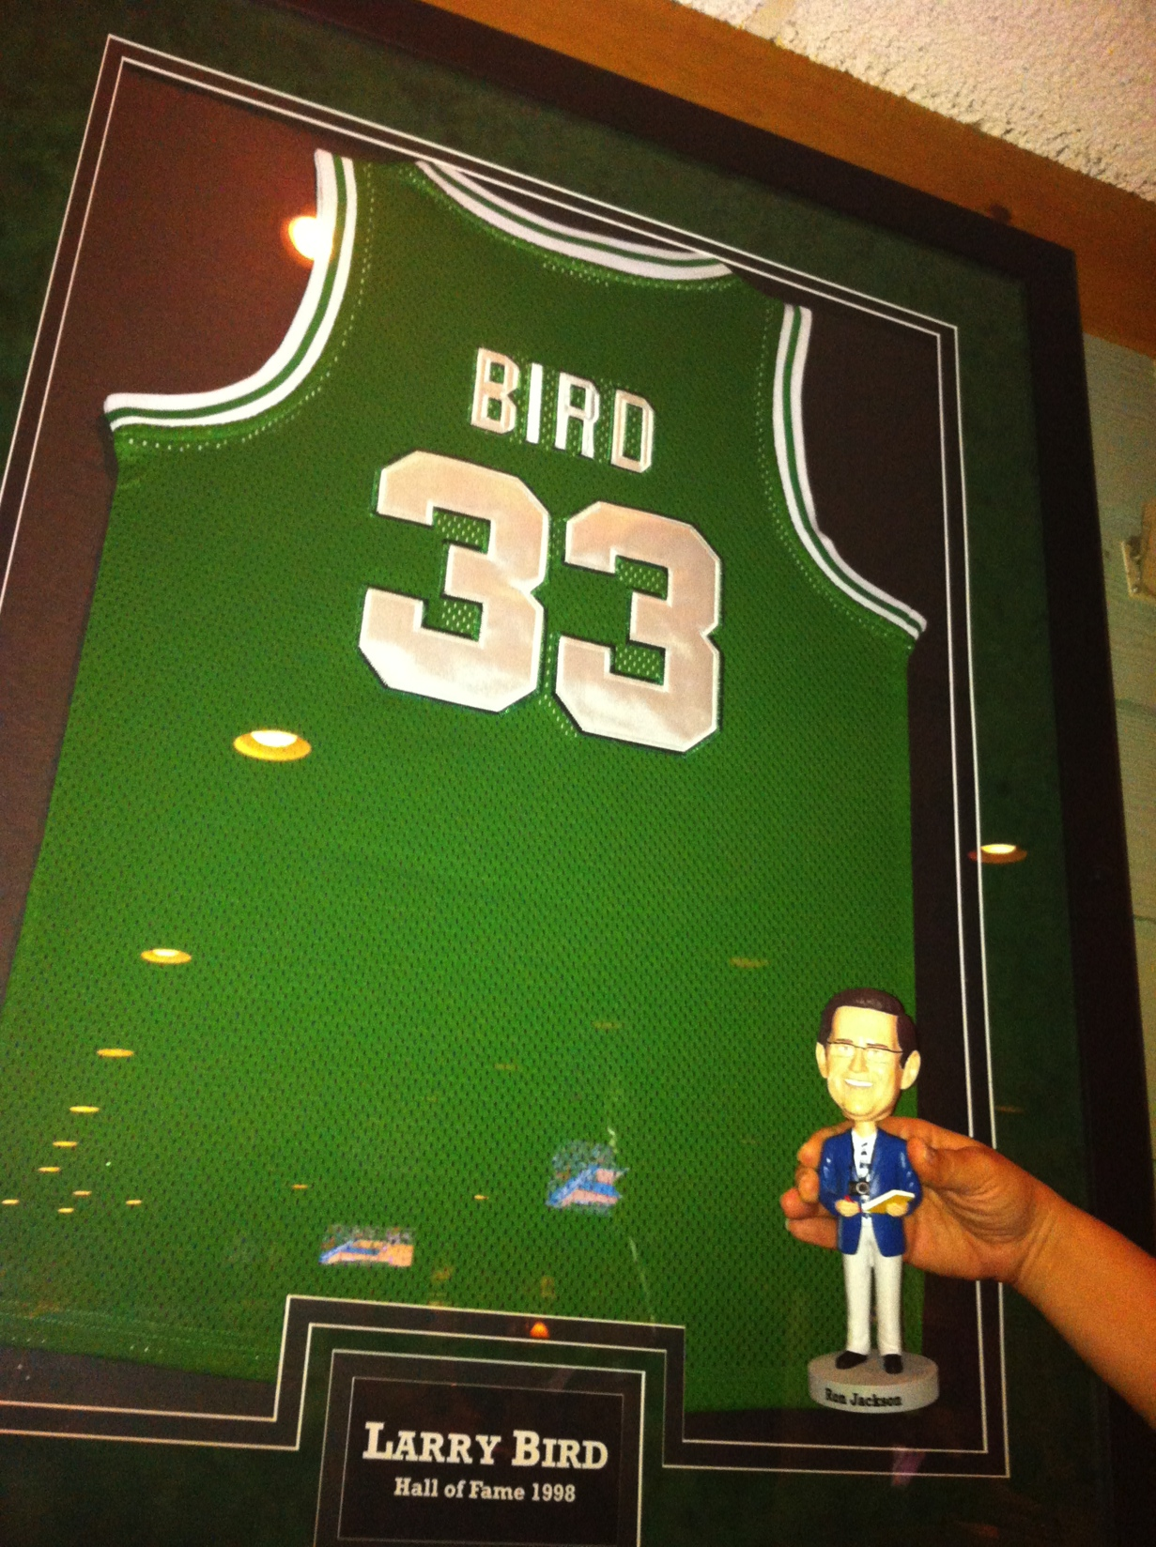
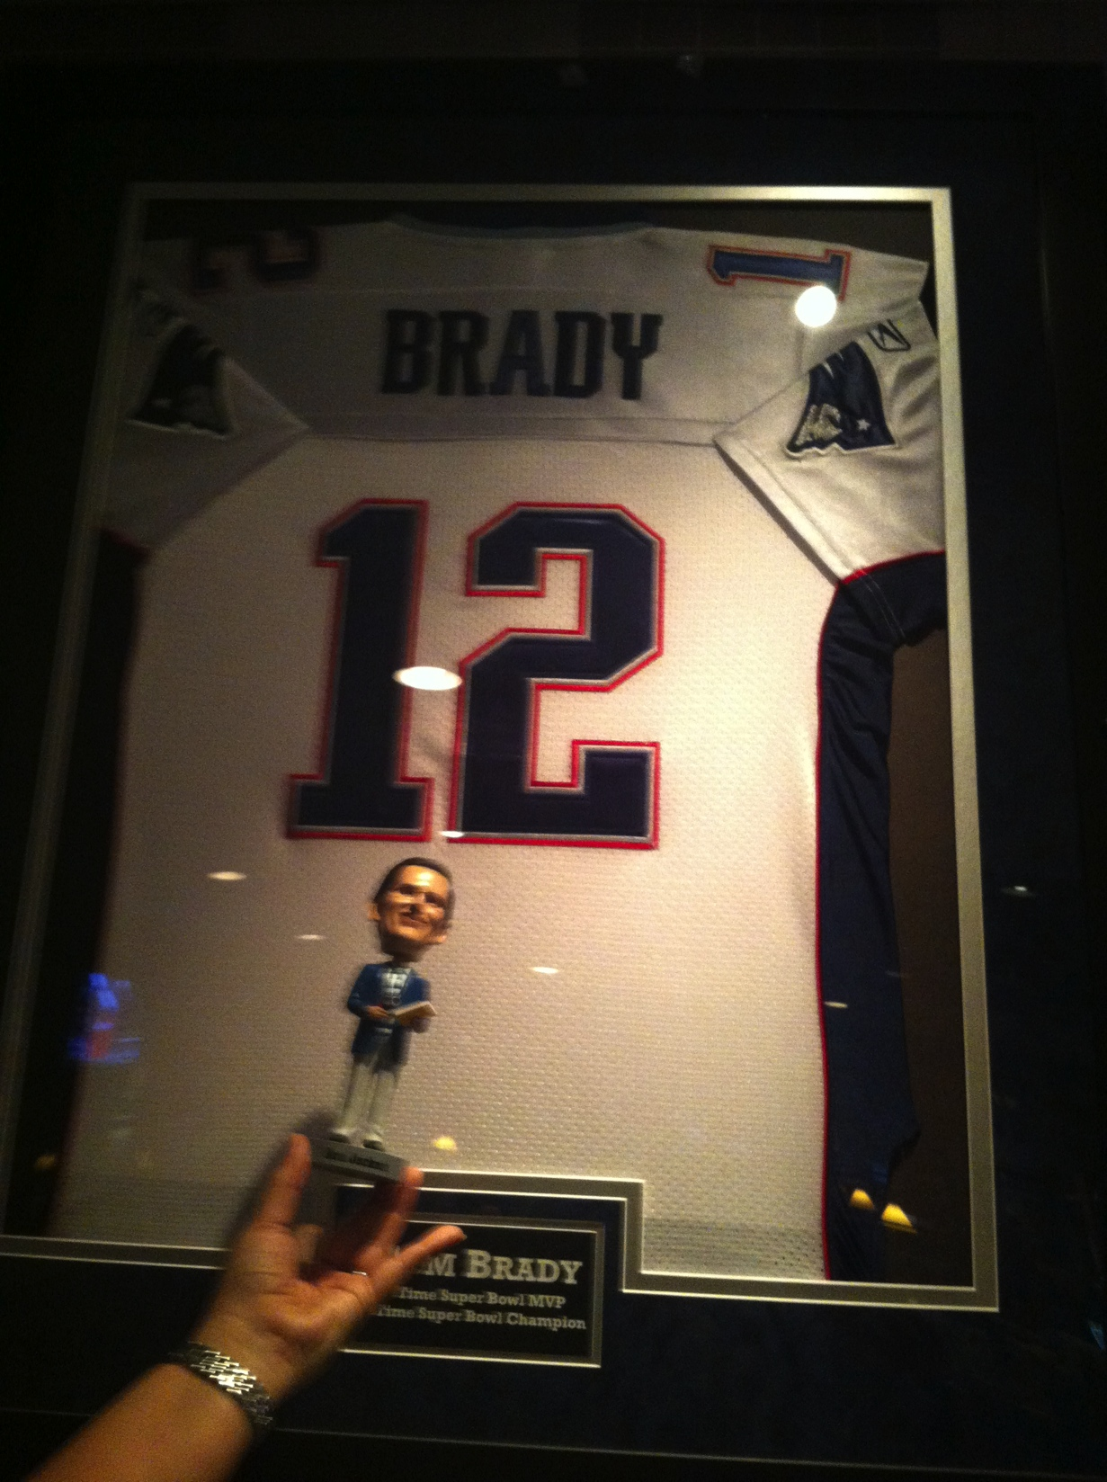
Ron with our favorite teams!
Red Sox – Celtics – Patriots

Slide 4
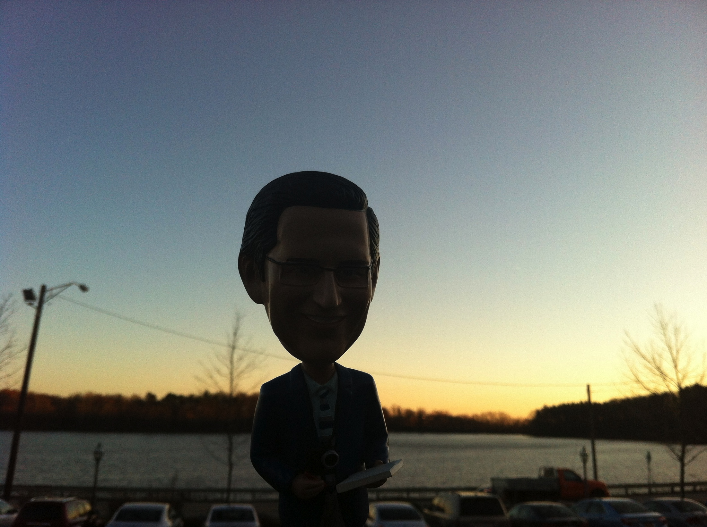
Interesting things start
Happening at Sundown……

Slide 5
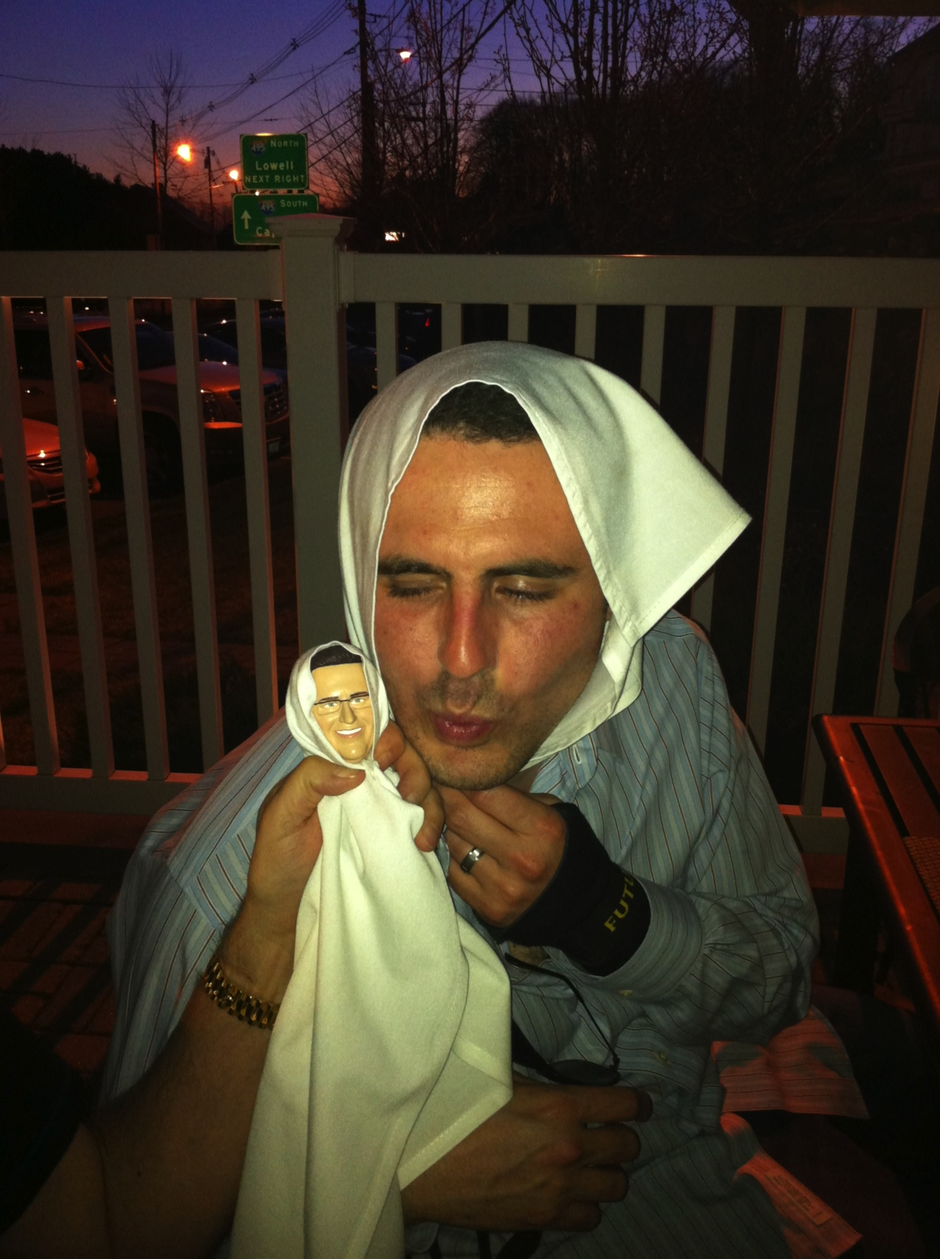
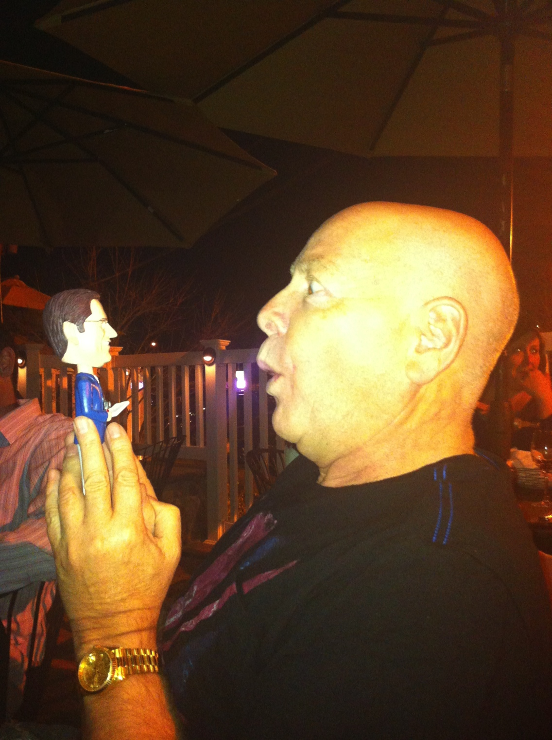
Look-a-Likes
Deep Conversations

Slide 6
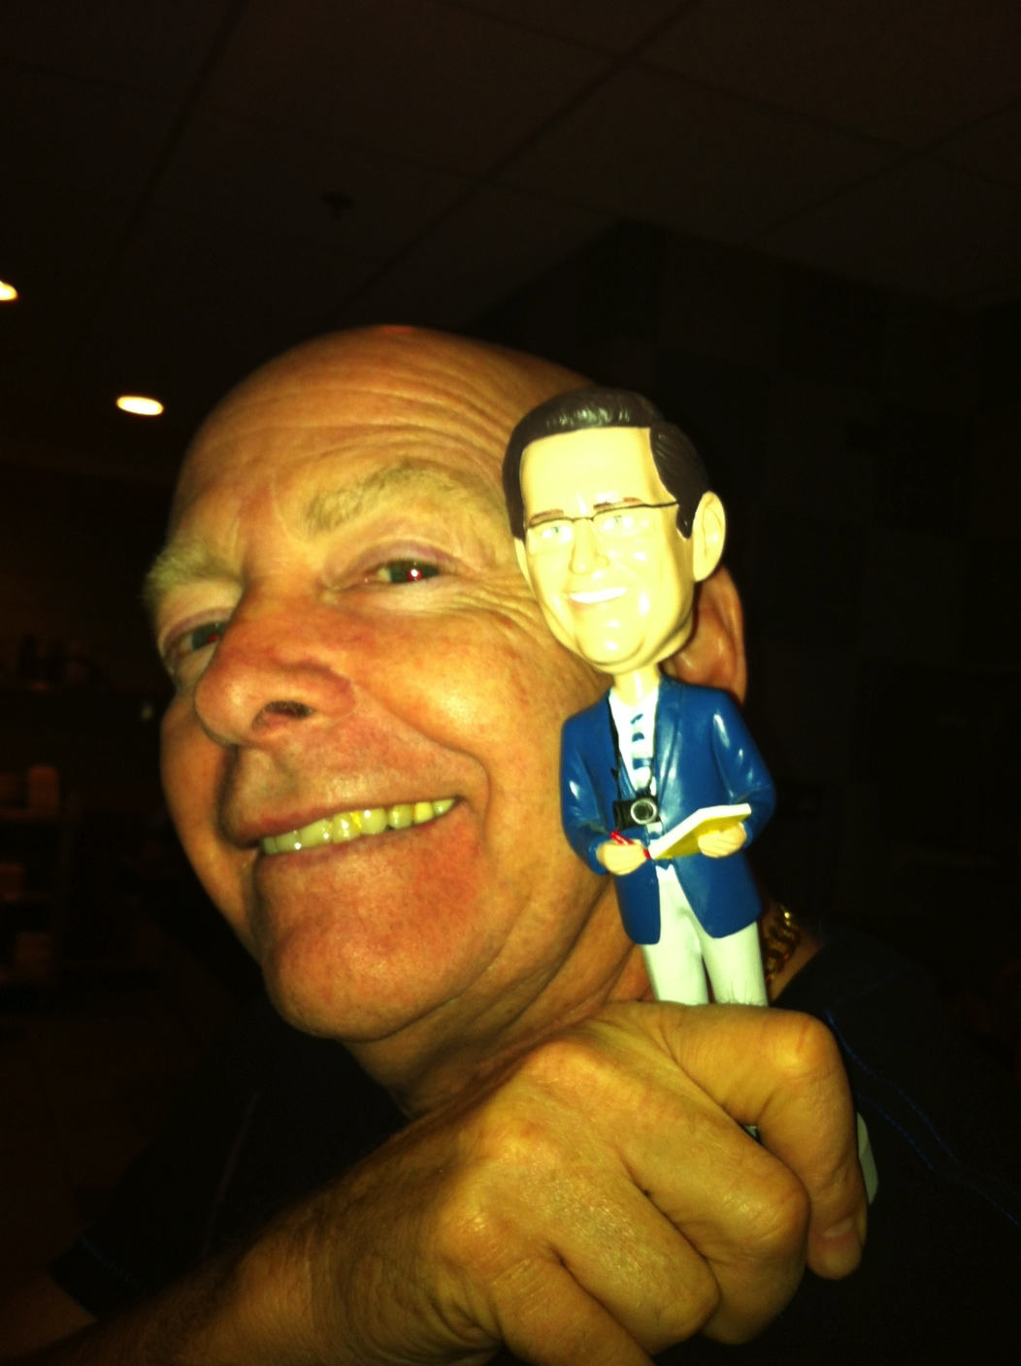
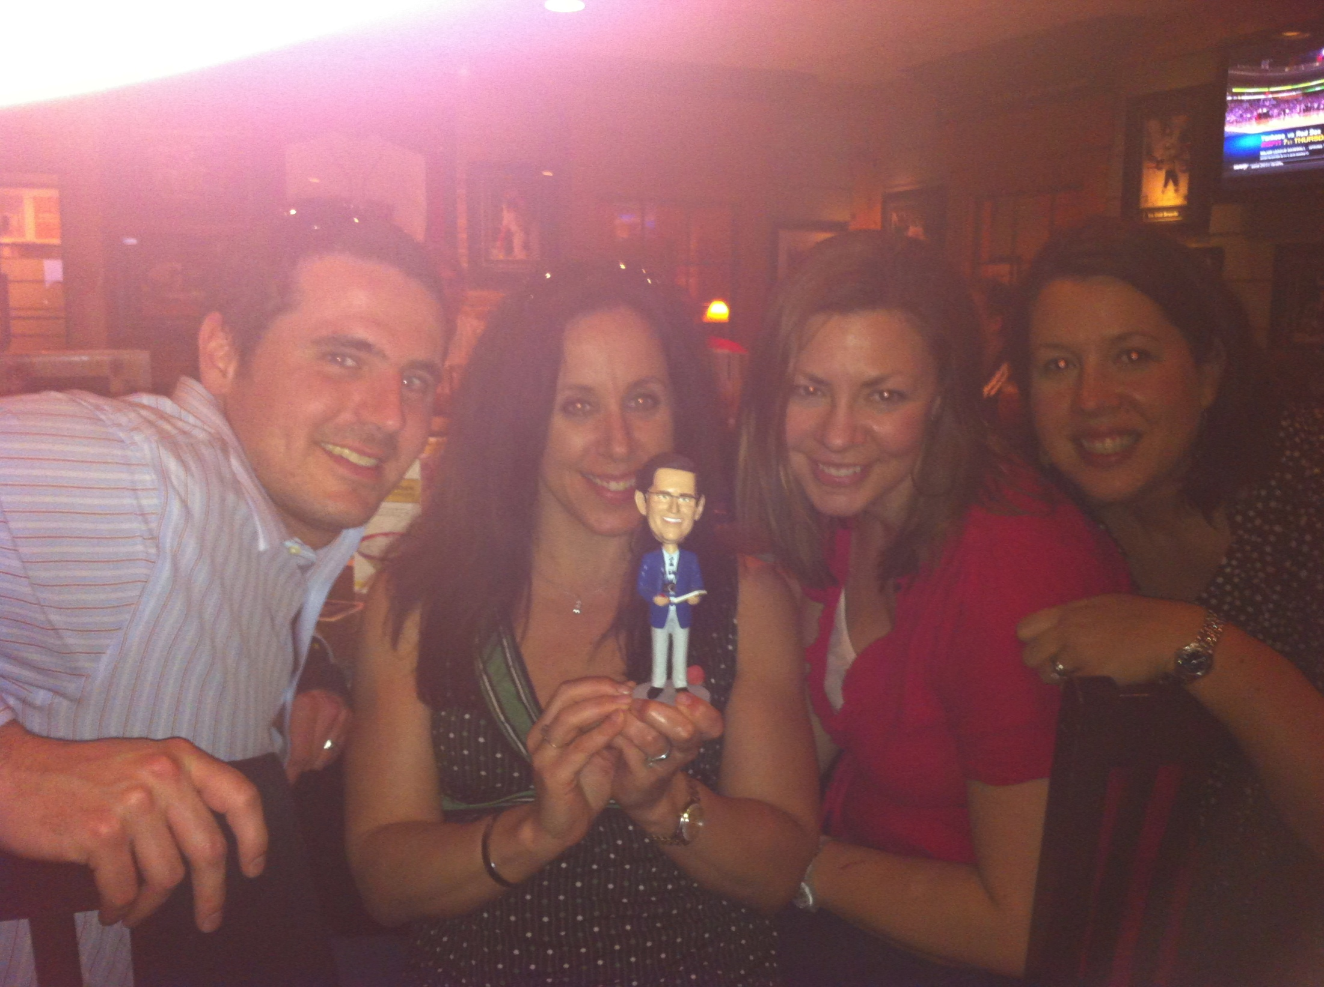
Old Friends
Jeff Gabriel, Tessa Holcomb, Gina Aubrey & Amanda Waltz
Gregg McNair

Slide 7
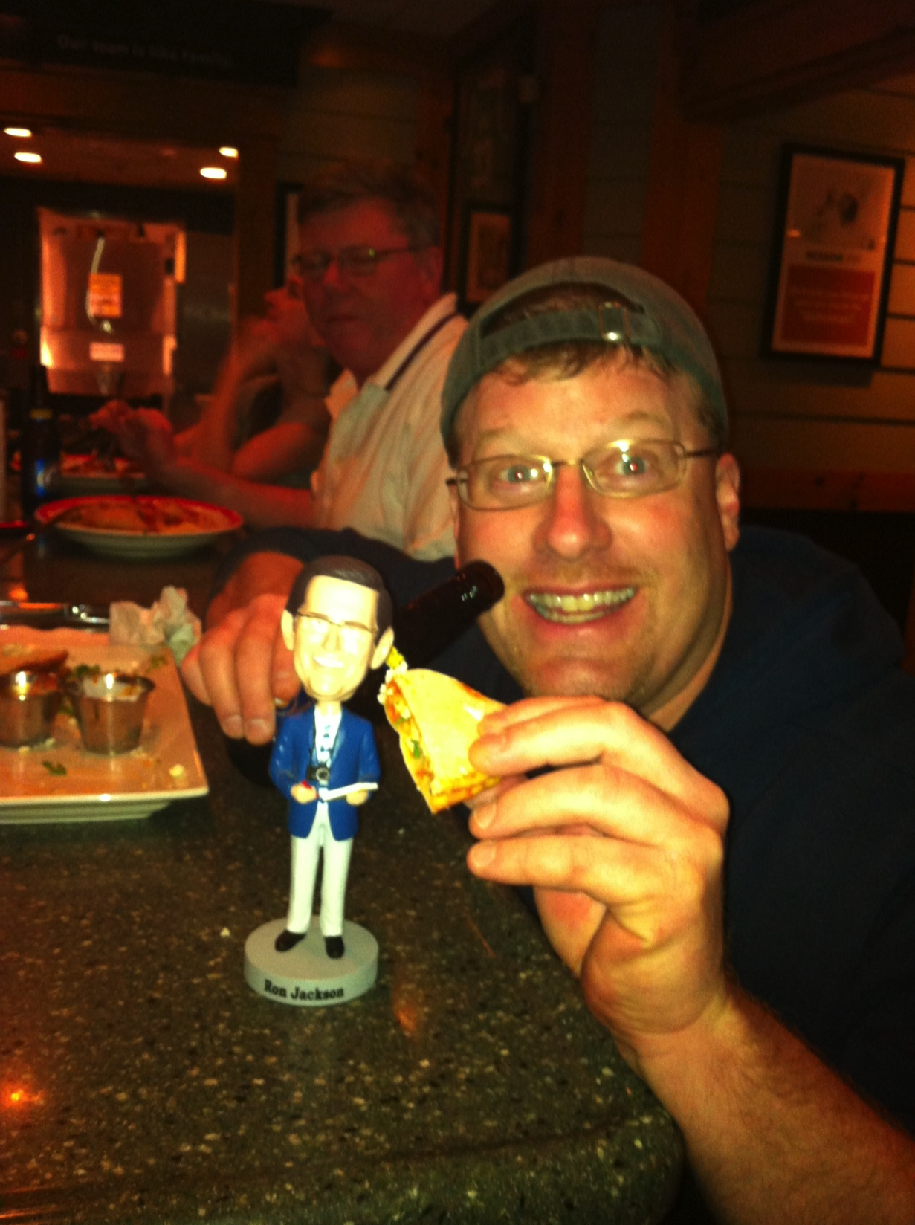
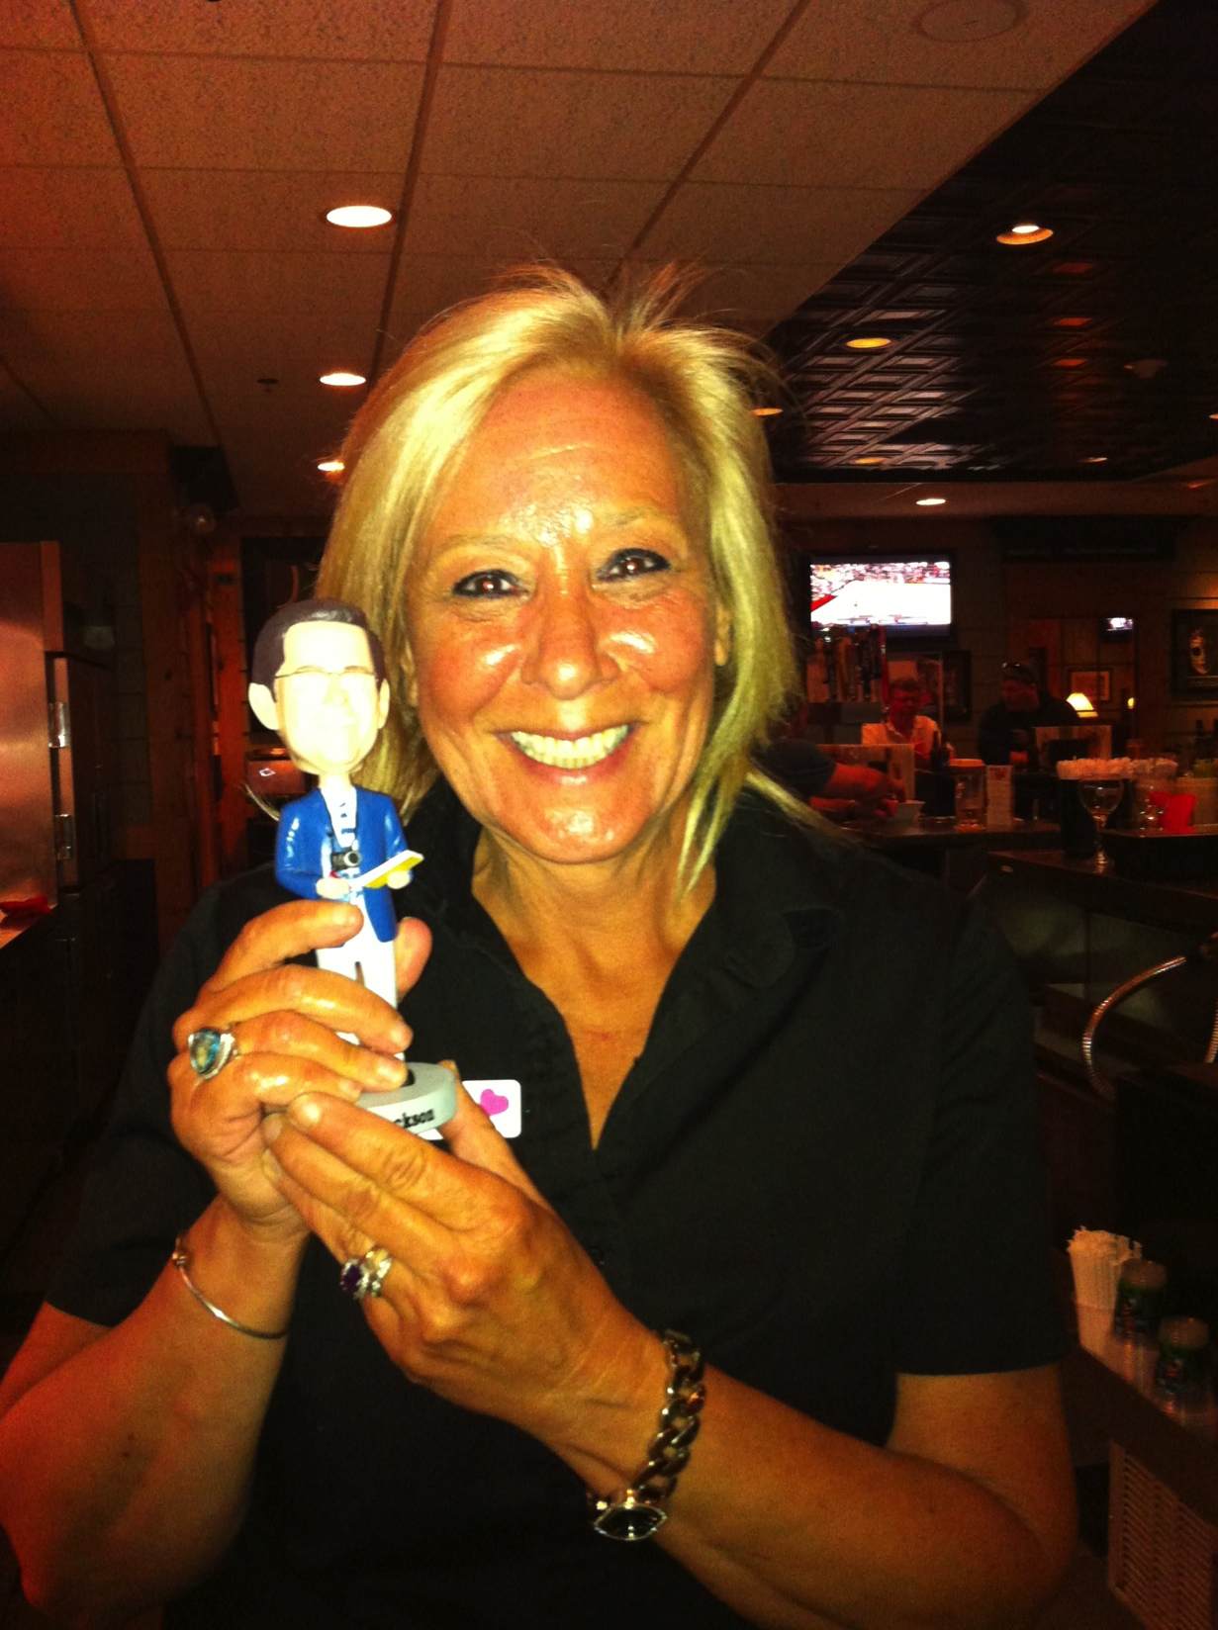
New Friends!
Please note that we do not know these people. They just really thought Ron seemed like a great guy and wanted to be in on the action!

Slide 8
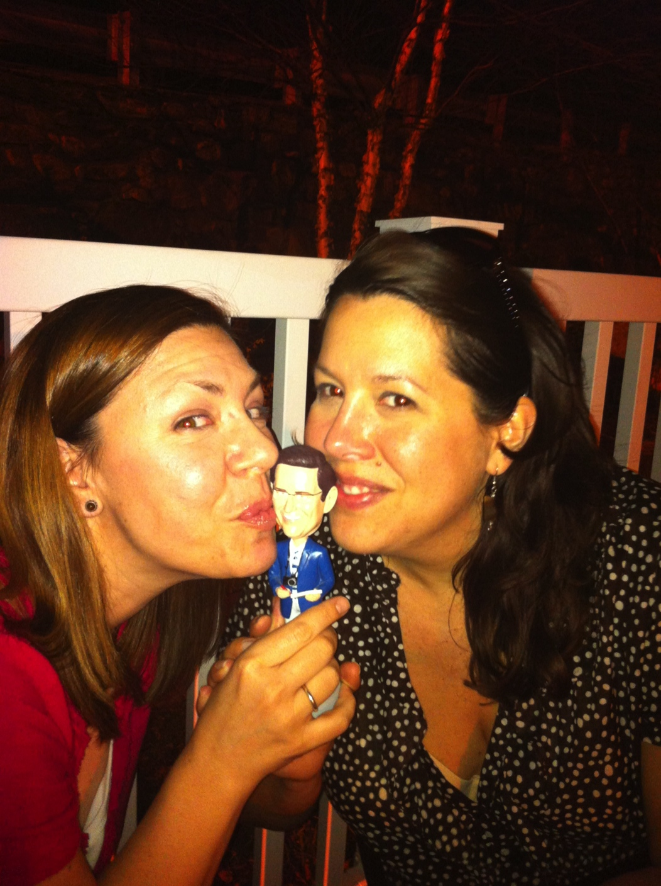
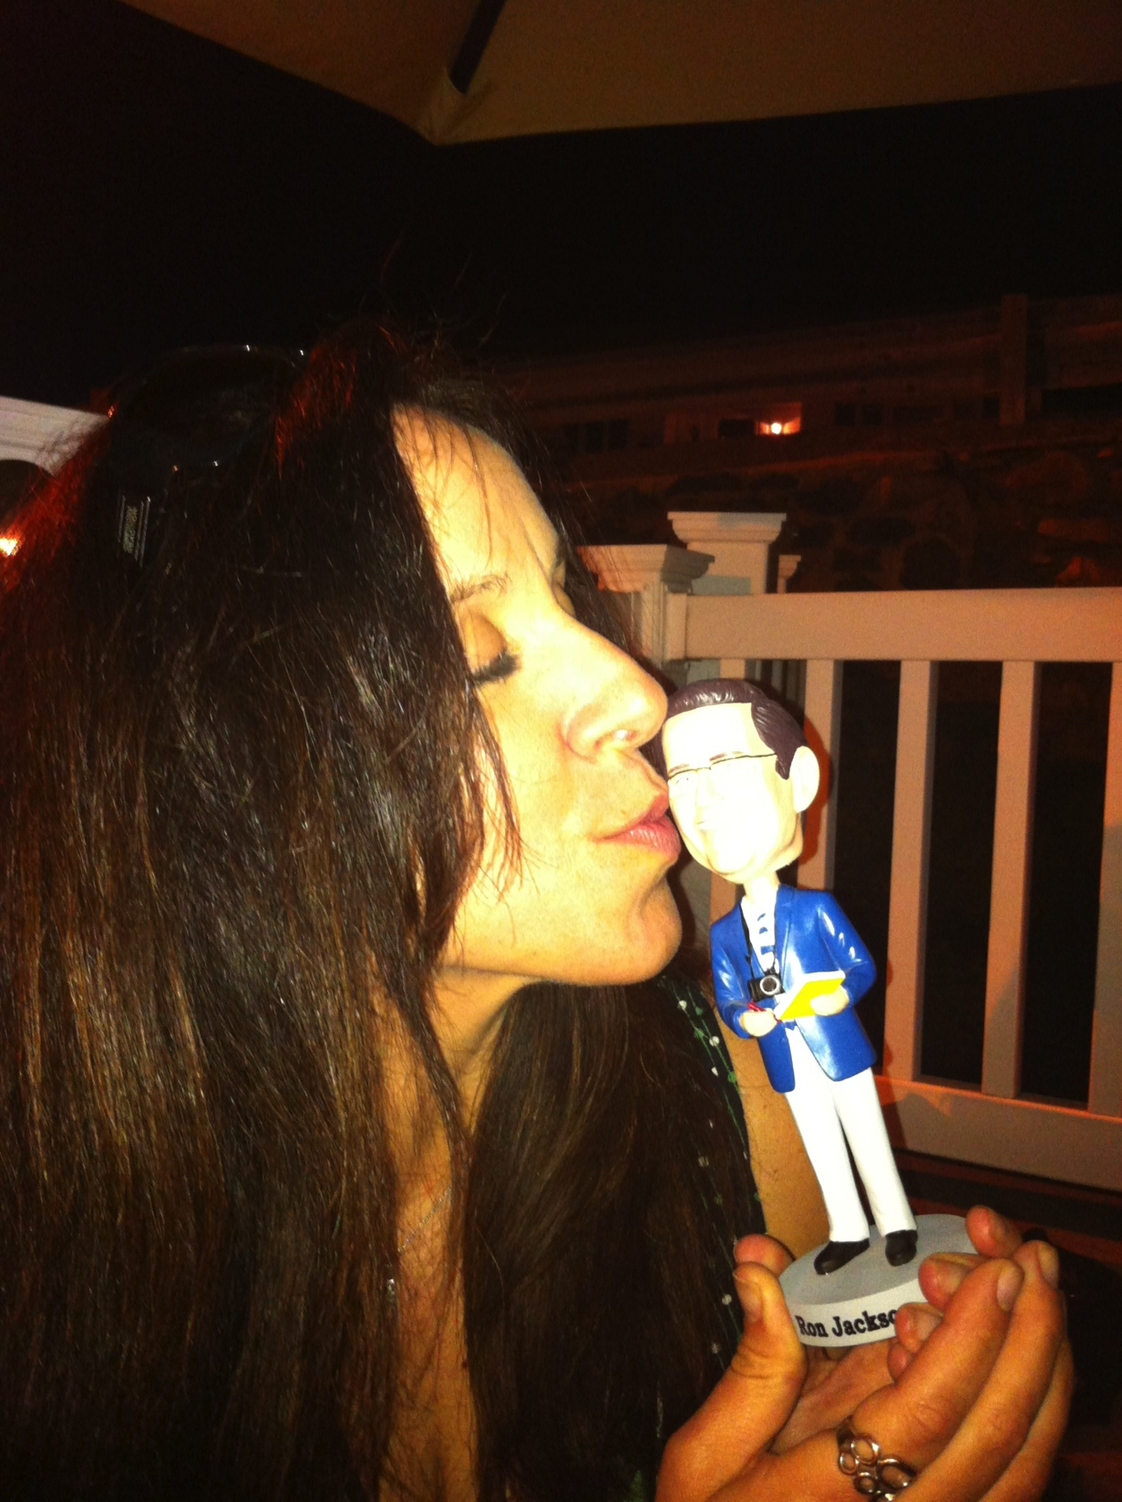
Congratulations, Ron - We Love You!!!
Wish we could be there!!!

